Slide 1

Hyperborea 3e
Character Creation
How to roll up character so you can play THE BEST GAME
ARBITER'S ARCHIVE
Like, Comment, Subscribe
2026.08.04

Slide 2
Character Creation in Hyperborea 3e
Step 0: Supplies – Hyperborea 3e books or PDFs, paper and pencil, dice, optionally a character sheet from https://www.hyperborea.tv/resources.html
Step 1: Generate Attributes – Choose one of the six methods available in the Player’s Manual
Step 2: Choose a Class – Select a character class that for which the generated attributes qualify
Step 3: Develop a Background – Choose or roll the various character background options
Step 4: Purchase Equipment – Roll for starting gold and purchase equipment, or utilize the starting kit for the selected class
Step 5: Determine Starting Spells – For sorcerous classes, randomly determine or select starting spells for the character
Step 6: Record Other Statistics – Based on attributes and equipment, record saving throw values, armour class, hit dice, hit points, movement, Fighting/Casting/Turning Ability
Character creation steps can be found on page 11 and 12 of the Player’s Manual
ARBITER'S ARCHIVE
Like, Comment, Subscribe
2026.08.04

Slide 3
Step 1 + Step 2
Generate Attributes
Choose a Class
I was a math major, so there are charts!
And my real job is management consulting, so yes, this is powerpoint.
ARBITER'S ARCHIVE
Like, Comment, Subscribe
2026.08.04

Slide 4
Step 1: Generate Attributes
METHOD I: Roll 3d6 in order for each attribute: Strength (ST), Dexterity (DX), Constitution (CN), Intelligence (IN), Wisdom (WS), and Charisma (CH).
METHOD II: Roll 3d6 in order for each attribute: Strength (ST), Dexterity (DX), Constitution (CN), Intelligence (IN), Wisdom (WS), and Charisma (CH). Repeat twice, generating three total arrays. Choose one set from the three arrays as your character.
METHOD III: Roll 4d6 and ignore the lowest die roll, repeating this process six times. Assign the six scores to the attributes as desired.
METHOD IV: Roll 3d6 three separate times for each attribute, in the order of the attributes: Strength (ST), Dexterity (DX), Constitution (CN), Intelligence (IN), Wisdom (WS), and Charisma (CH). The best result for each individual attribute is the score for that attribute.
METHOD V: Roll 2d6+6 in order for each attribute: Strength (ST), Dexterity (DX), Constitution (CN), Intelligence (IN), Wisdom (WS), and Charisma (CH).
METHOD VI: Choose a character class. For each attribute that has a minimum requirement, roll 4d6, dropping the lowest die. Repeat until the minimum score is attained. For attributes that do not have a minimum, roll 3d6.
ARBITER'S ARCHIVE
Like, Comment, Subscribe
2026.08.04

Slide 5
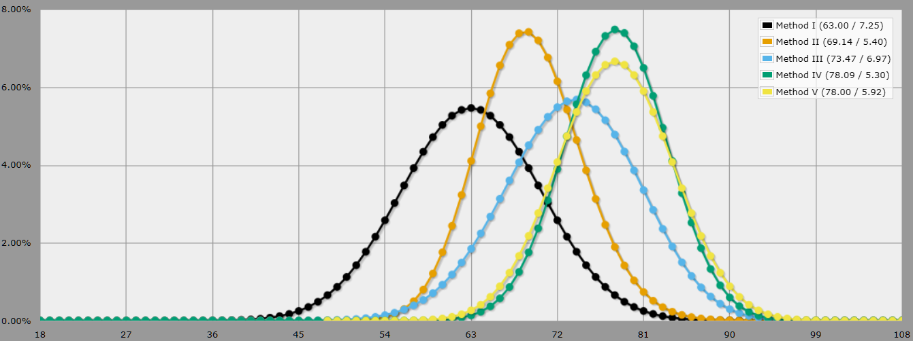
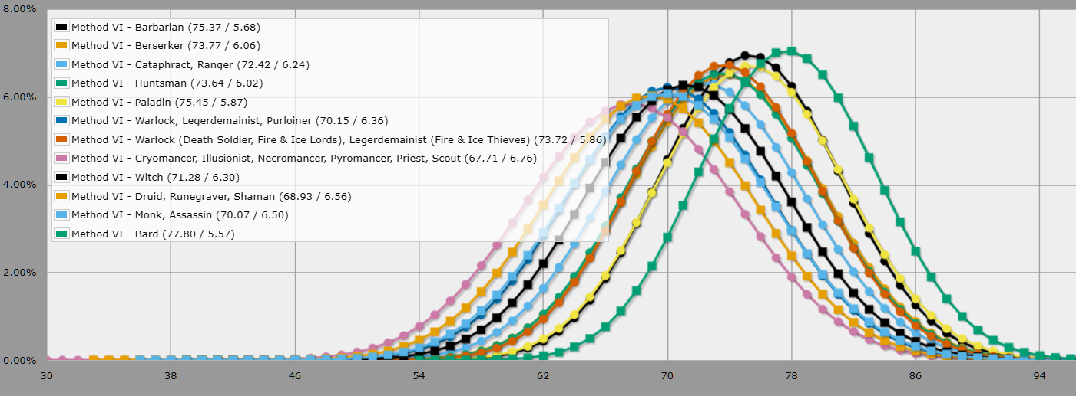
A long time ago, in a high school far, far away…
Method I has the highest risk of low scores.
This allows the character to emerge from the oldest generation method, but will make many classes far more rare.
Methods III, IV, and V have higher averages
All three have a noticeably higher (13 vs 10.5) expected average value, as well as a tighter distribution.
Method VI allows a class selection and the stats to support it.
You’ll be good enough to meet the requirements of a given class, but are unlikely to be a powerhouse. A good choice for Barbarians, Bards, and Paladins, though.
Charts generated using Anydice.com
ARBITER'S ARCHIVE
Like, Comment, Subscribe
2026.08.04

Slide 6
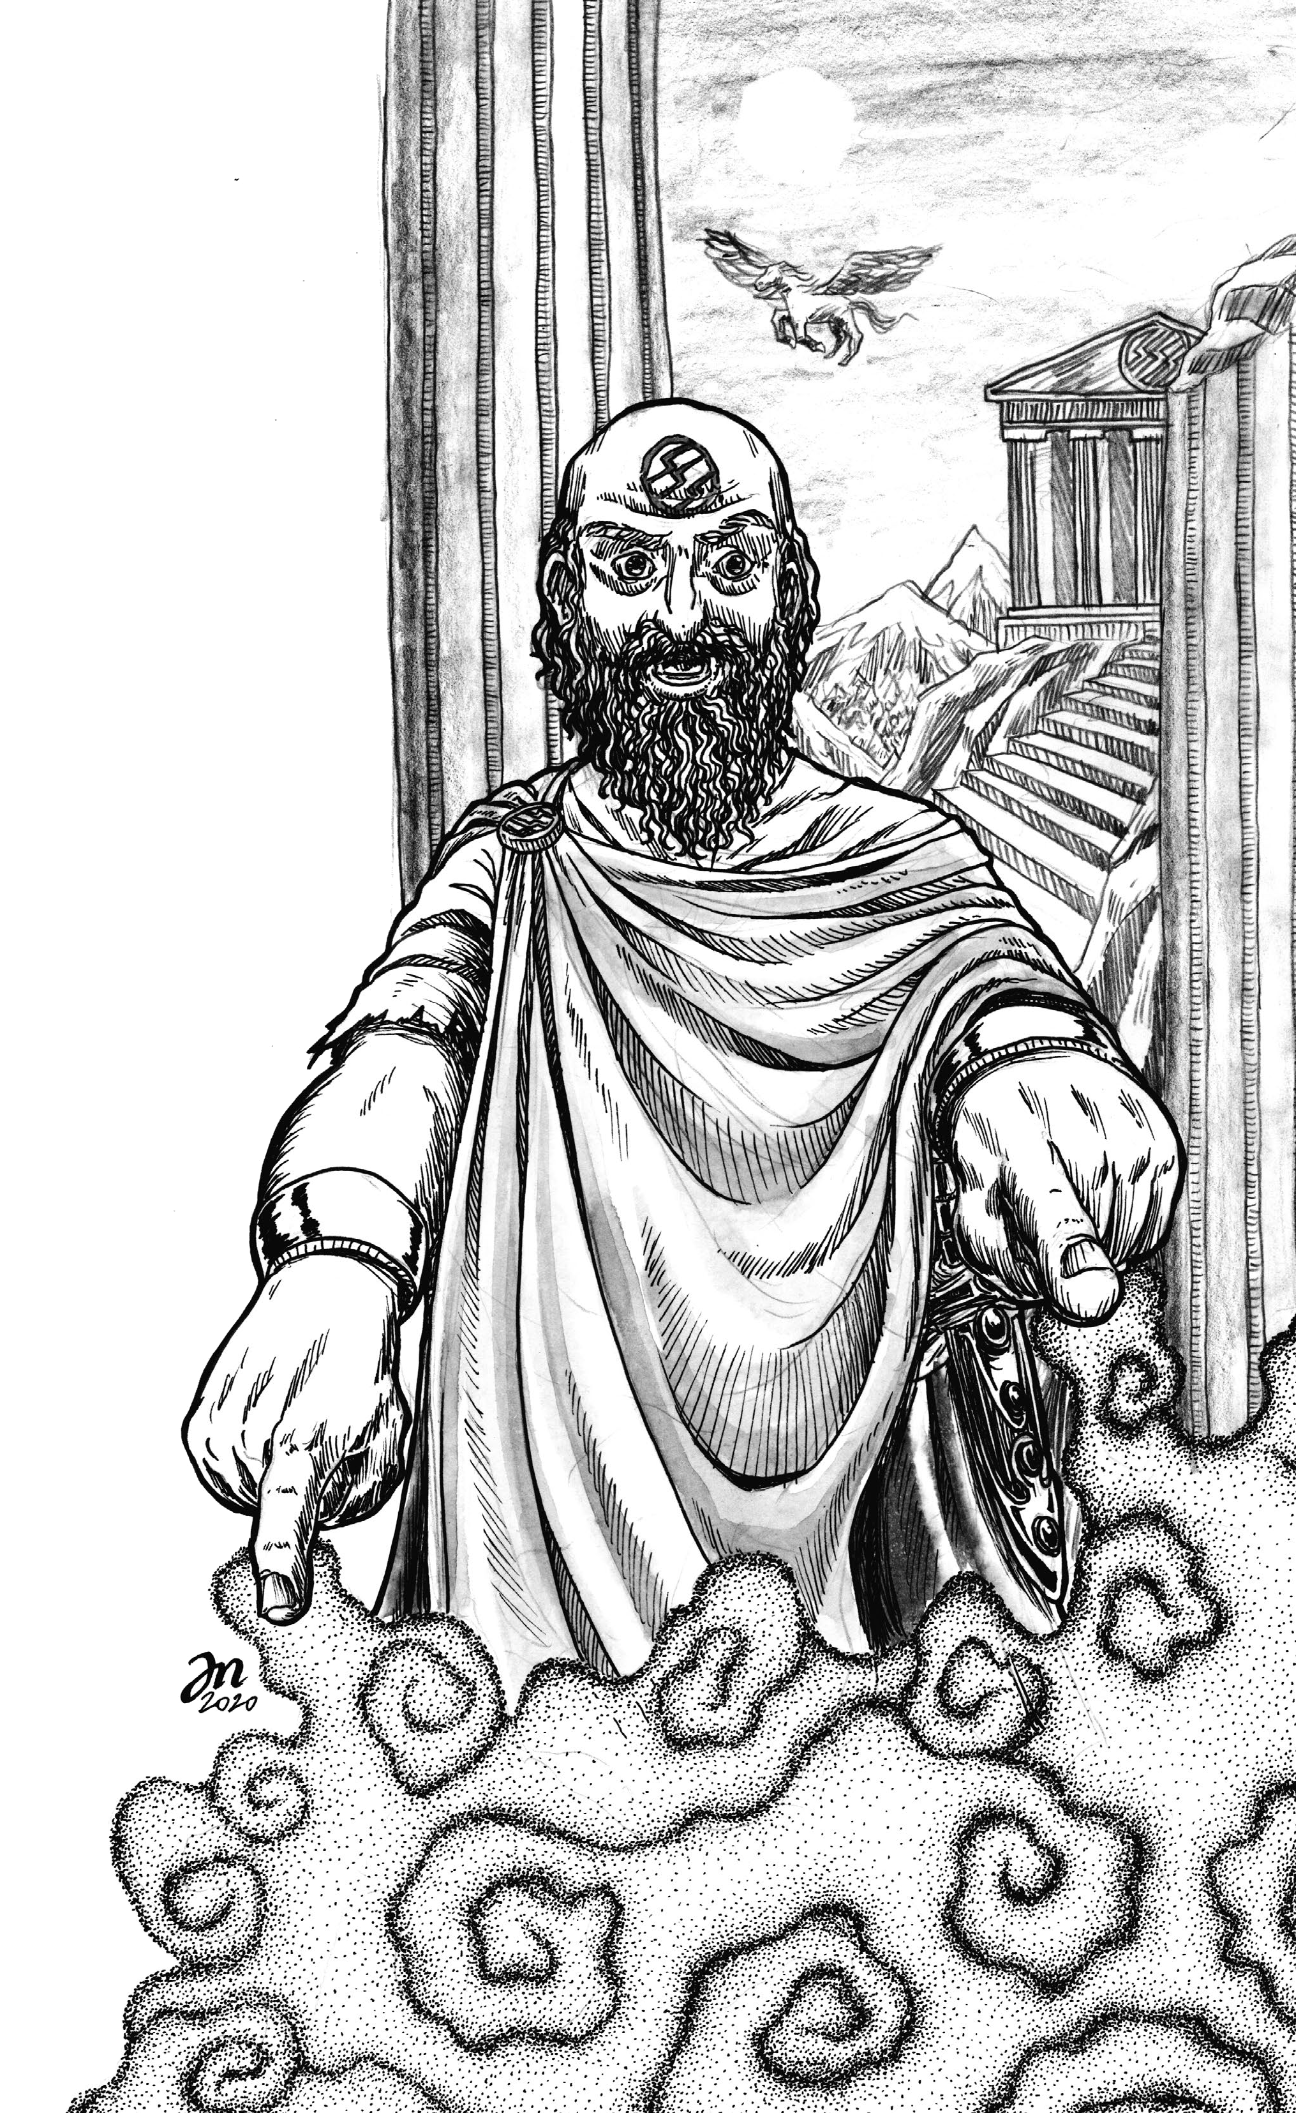
METHOD I · The OG Method
THE ROLLS
3d6 down the line
ST 10 DX 8 CN 8
IN 7 WS 12 CH 10
QUALIFYING CLASSES
Fighter · Cleric · Priest · Runegraver
CLASS CHOICE & REASON
Priest – Ecclesiastical sorcerer; more spells than any other sorcererous class, weak in physical combat.
ADJUSTED ATTRIBUTES
ST 4 (−6) DX 9 (+1)
CN 9 (+1) IN 7
WS 13 (+1) CH 10
WHY ADJUST?
Remove AC and hit point penalties from DX and CON.
Gain one additional 1st-level cleric spell per day from WIS.
ARBITER'S ARCHIVE
Like, Comment, Subscribe
2026.08.04

Slide 7
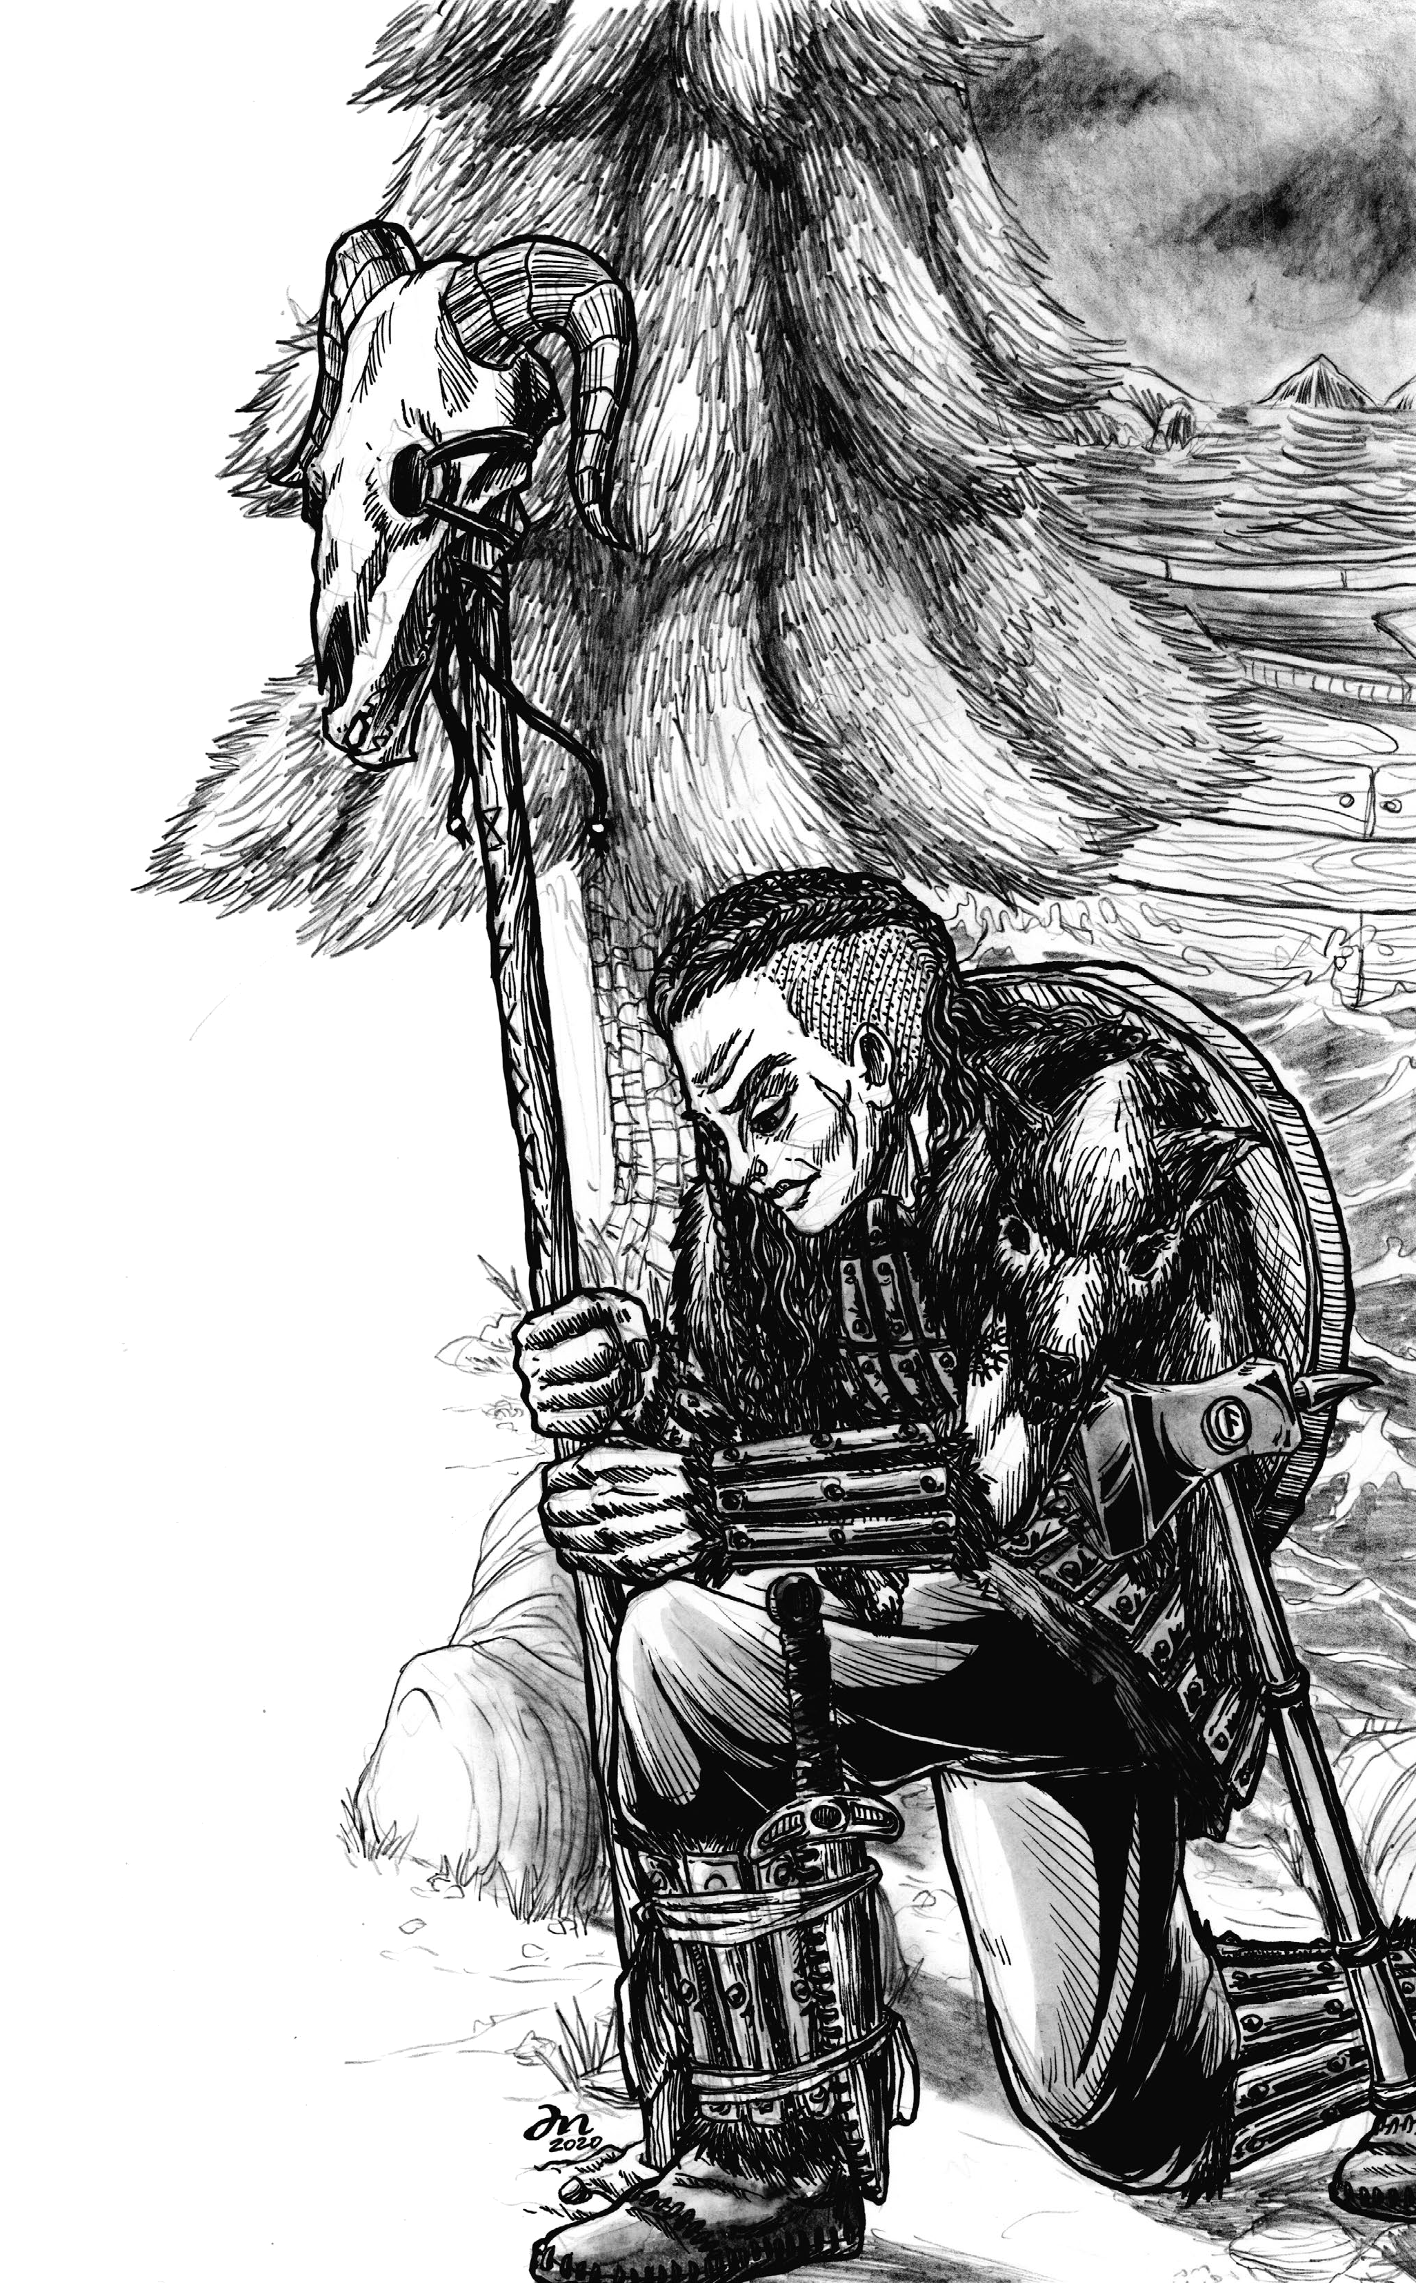
METHOD II · The OG x3
THREE ARRAYS — PICK ONE COLUMN
ST 12 10 16
DX 9 13 11
CN 13 10 10
IN 13 14 12
WS 12 10 12
CH 11 11 8
QUALIFYING CLASSES
Fighter · Thief · Cleric · Magician · Ranger · Warlock · Cryomancer · Illusionist · Necromancer · Pyromancer · Monk · Runegraver · Shaman · Assassin · Scout
CLASS CHOICE & REASON
Runegraver – The Runegraver best benefits from high Strength and Wisdom scores. Warlock was also a consideration.
ADJUSTED ATTRIBUTES
ST 16 DX 11
CN 10 IN 6 (−6)
WS 16 (+4) CH 6 (−2)
WHY THIS ARRAY?
ST and WS at 16+ secure the +10% XP bonus.
ARBITER'S ARCHIVE
Like, Comment, Subscribe
2026.08.04

Slide 8
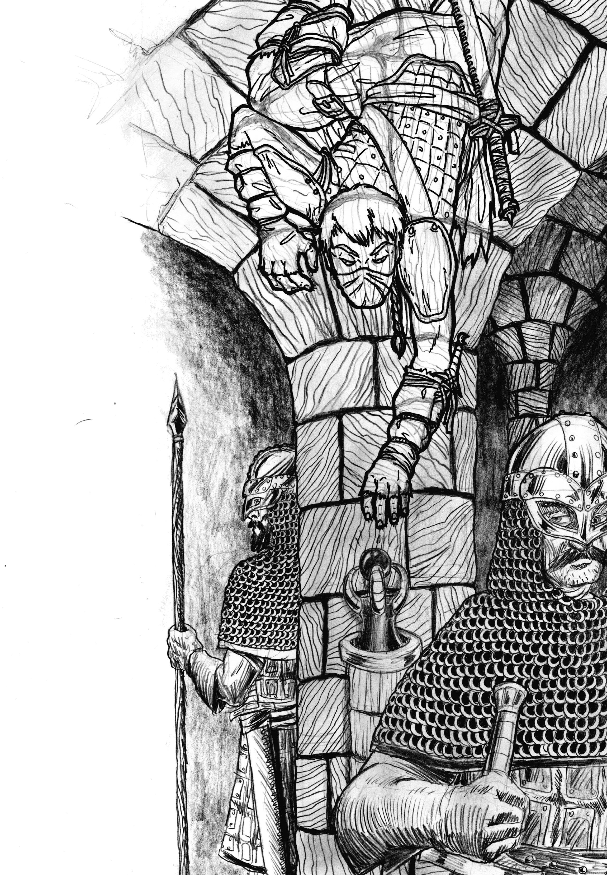
METHOD III · The Modern Standard
THE ROLLS
4d6, drop the lowest
Assign the six results as desired.
17 - 13 - 12
12 - 13 - 13
QUALIFYING CLASSES
Every class except Berserker.
CLASS CHOICE & REASON
Legerdemainist – The illusionist school offers an interesting spell list that rewards player creativity, and the Thief abilities are useful for party play.
ADJUSTED ATTRIBUTES
ST 10 (-2) DX 17
CN 11 (-2) IN 17 (+4)
WS 12 CH 9 (-4)
WHY ADJUST?
DX and IN at 16+ secure the +10% XP bonus.
ARBITER'S ARCHIVE
Like, Comment, Subscribe
2026.08.04

Slide 9
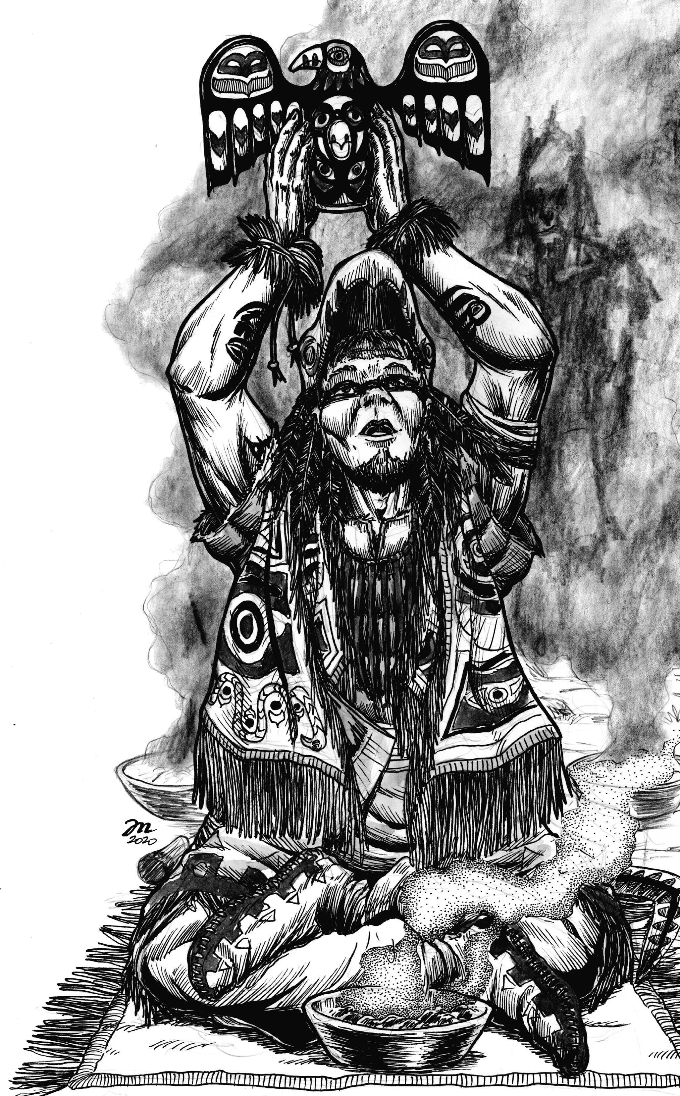
METHOD IV · Method II Redux
ROLL THREE TIMES; KEEP EACH BEST
ST 12 13 14
DX 5 8 7
CN 13 11 9
IN 13 9 14
WS 14 8 10
CH 8 14 6
QUALIFYING CLASSES
Fighter · Magician · Cleric · Warlock · Cryomancer · Necromancer · Pyromancer · Witch · Druid · Priest · Runegraver · Shaman
CLASS CHOICE & REASON
Shaman – Many classes are a solid option with this array, but Shaman offers a wide variety of sorcery options on a single character.
ADJUSTED ATTRIBUTES
ST 10 (−4) DX 8
CN 13 IN 16 (+2)
WS 16 (+2) CH 10 (−4)
WHY ADJUST?
IN and WS at 16+ secure the +10% XP bonus.
ARBITER'S ARCHIVE
Like, Comment, Subscribe
2026.08.04

Slide 10
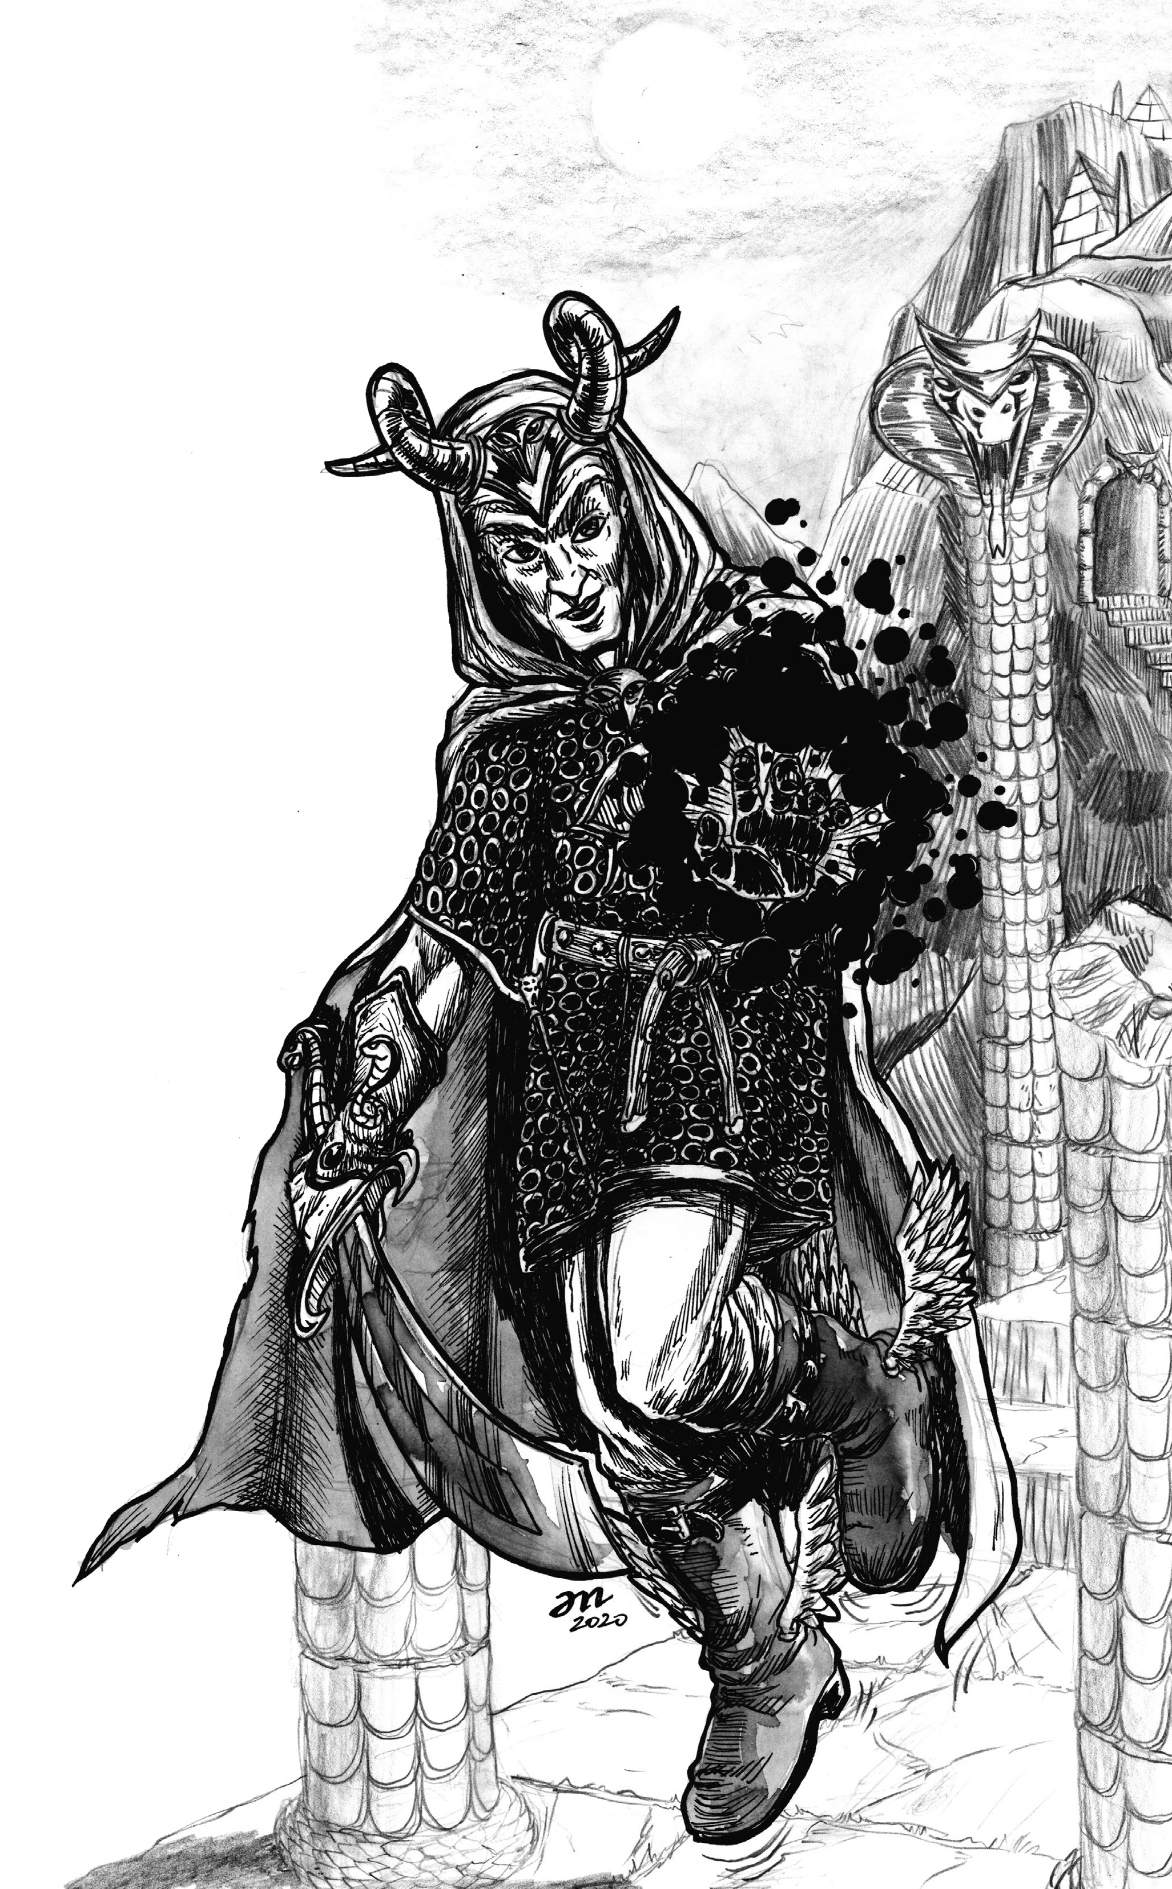
METHOD V · My Personal Favorite
THE ROLL
2d6 + 6 in order
ST 16 DX 10 CN 12
IN 17 WS 12 CH 14
QUALIFYING CLASSES
All except Barbarian, Berserker, Paladin, Bard, Legerdemainist, and Purloiner.
CLASS CHOICE & REASON
Warlock – Incredibly strong ST and IN stats were generated immediately, covering the requirements for 10% XP bonus immediately.
ADJUSTED ATTRIBUTES
ST 17 (+1) DX 10
CN 15 (+3) IN 17
WS 10 (−2) CH 8 (−6)
WHY ADJUST?
Prime attributes become eligible for the +10% XP bonus.
Also: warlocks are awesome.
ARBITER'S ARCHIVE
Like, Comment, Subscribe
2026.08.04

Slide 11
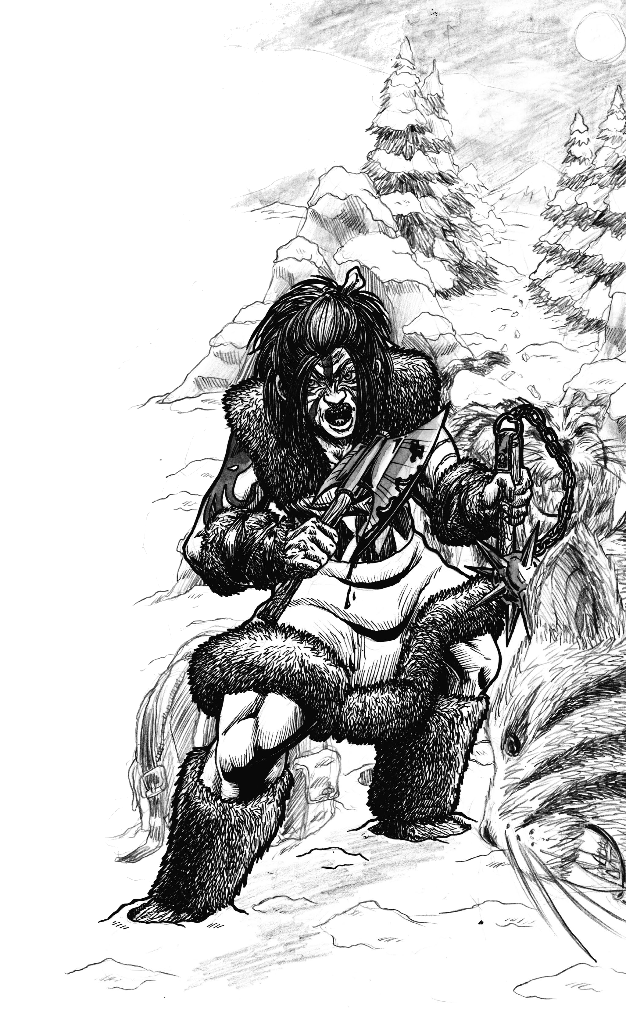
METHOD VI · Choose the class first
THE CLASS
Berserker – Requiring two attributes over 15 (ST and CN) makes it a difficult class to qualify for.
THE ROLL
Use 3d6 for attributes with no requirement.
Use 4d6, drop low—and reroll until the minimum—for required attributes.
ST 15 DX 12
CN 9 → 12 → 8 → 15
IN 5 WS 12 CH 9
ADJUSTED ATTRIBUTES
ST 16 (+1) DX 15 (+3)
CN 16 (+1) IN 5
WS 6 (−6) CH 6 (−4)
WHY ADJUST?
ST and CN at 16 for a +10% XP bonus.
DX 15 improves defense.
Don’t need smarts if you can smash!
THE TRADEOFF
Your class is protected; the rest of the character can be gloriously uneven.
ARBITER'S ARCHIVE
Like, Comment, Subscribe
2026.08.04

Slide 12
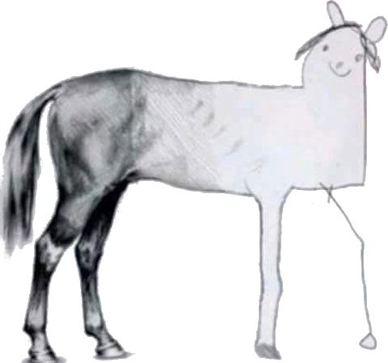
Steps 3-6
Finish the Character
Backgrounds, Equipment, and Spells
ARBITER'S ARCHIVE
Like, Comment, Subscribe
2026.08.04

Slide 13
STEP 3 – Develop a Background – Pick or Roll!
RACE Choose a culture or roll d%; 96-00 leads to the ancillary-race table.
PHYSIQUE Choose or roll gender, age, height, weight, eyes, hair, and complexion.
ALIGNMENT Pick a world view permitted by the character class.
LANGUAGES Begin with Common and a native tongue; IN 13+ grants bonus languages.
RELIGION Select a deity, pairing, totem, ethos, or no formal faith.
SECONDARY SKILL Roll a column and row on Table 72, or select with referee approval.
Tables for these elements are found starting on page 114 of the Player’s Manual.
For purposes of this exercise, I chose races and genders that matched the art in the books, rather than random determination.
ARBITER'S ARCHIVE
Like, Comment, Subscribe
2026.08.04

Slide 14
STEP 4 – Class Packs vs. Purchase Equipment
OPTION A - CLASS PACK Take the ready-made list printed with the class.
OPTION B - STARTING GOLD Roll the class's starting money, then buy armour, shields, weapons, and gear.
Make note of class limitations for armour, shields, and weapons. Track carried items, ammunition, containers, money, armour class, and movement.
For this video, all six characters take their class starting pack, because I hate shopping episodes.
Each pack also supplies 1d4+1 gp; those pocket-money rolls are recorded on the character slides.
Class packs are found in each Class’s section of Chapter 4. Equipment tables are found in Chapter 6: Equipment, starting on page 136 of the Player’s Manual.
ARBITER'S ARCHIVE
Like, Comment, Subscribe
2026.08.04

Slide 15
STEP 5 – Determine Starting Spells
FIND THE SPELL LIST The class states the schools, levels, and number of starting spells. Spell lists start on page 165 of the Player’s Manual.
ROLL d% Match each result to the uncover range in the appropriate spell-list table. Or pick your favorites if your Referee is amenable.
REROLL REPEATS Reroll duplicate results; all known spells are distinct.
RECORD BOTH TOTALS Known spells and spells cast per day are not always the same.
KNOWN SPELLS FOR THE GENERATED CHARACTERS:
Priest: 4 cleric spells Legerdemainist: 1 illusionist spell
Shaman: 1 druid spell at 1st level Warlock: 1 magician spell.
Runegraver rolls its class rune table Berserker has no spells.
Chapter 7: Sorcery begins on page 156 of the Player’s Manual.
ARBITER'S ARCHIVE
Like, Comment, Subscribe
2026.08.04

Slide 16
STEP 6 – Record Other Statistics
ARMOUR CLASS (AC) Start with armour, then improve it for shield and DX defence bonuses.
HIT POINTS (HP) Roll the class hit die and apply the CN adjustment; minimum 1 hp.
Many referees will house-rule maximum HP at level 1.
MOVEMENT Use the armour movement rate:
none/light 40 ft./round · medium 30 ft./round · heavy 20 feet per round.
CLASS VALUES Copy SV, FA, CA, and TA from the 1st-level class table.
SV – Saving Throw FA – Fighting Ability CA – Casting Ability TA – Turning Ability
CASTS PER DAY Apply eligible IN or WS bonus spells to the class spell schedule.
ARBITER'S ARCHIVE
Like, Comment, Subscribe
2026.08.04

Slide 17
ZOTIKOS - PRIEST
BACKGROUND
Greek man, age 24; 5 ft. 9 in., 170 lb.
Black hair, hazel eyes; Lawful Good.
Common + Hellenic; Apollo; scribe/scrivener.
PRIEST STARTING PACK
Silver dagger, quarterstaff, whip; backpack, bandages, blanket, religious clothing.
Silver holy symbol, holy water, prayer beads; rations, sack, tinderbox, 3 torches, wineskin, writing stick; 4 gp.
CLERIC SPELLS - 4 KNOWN
d% (54) - Detect Venom
d% (14) - Ceremony of Consecration
d% (03) - Bless
d% (57) - Light
Casts 3 level 1 spells/day: 2 base + 1 WIS.
OTHER STATISTICS
AC 9 - MV 40 - HD 1d4
HP 3: roll 3, CN +0
SV 16 - FA 0 - CA 1 - TA 1
ARBITER'S ARCHIVE
Like, Comment, Subscribe
2026.08.04

Slide 18
SIGRID - RUNEGRAVER
BACKGROUND
Viking woman, age 19; 5 ft. 11 in., 175 lb.
Blond hair, blue eyes; Chaotic Good.
Common + Old Norse; Ymir and Ullr; brewer/vintner.
RUNEGRAVER STARTING PACK
Studded armour; battle axe, short bow, 12 arrows, 2 silver arrows, dagger.
Quiver, backpack, bandages, chalk, dice, holy symbol, drinking horn, rations, tinderbox, 2 torches, waterskin, writing stick; 4 gp.
STARTING RUNE
d3 (2) Man rune - Command
Invokes 1 level-1 rune/day; costs 1 hp to cast.
OTHER STATISTICS
AC 6: studded armour
MV 40 - HD 1d8
HP 8: roll 8, CN +/-0
SV 16 - FA 1 - CA 1 - TA n/a
ARBITER'S ARCHIVE
Like, Comment, Subscribe
2026.08.04

Slide 19
CUNOVINDOS - LEGERDEMAINIST
BACKGROUND
Pict man, age 22; 5 ft. 8 in., 145 lb.
Red hair, green eyes; Neutral.
Common + Keltic (Pictish) + Old Norse; Rel; locksmith.
LEGERDEMAINIST STARTING PACK
Studded armour, small shield; 2 daggers, falcata, sling + 20 bullets.
Backpack, bandages, blanket, writing kit, rations, rope, sack, thieves' tools, tinderbox, 2 torches, wineskin, spell book; 3 gp.
ILLUSIONIST SPELL - 1 KNOWN
d% (27) - Detect Invisibility
Casts 2 level 1 spells/day: 1 base +1 INT.
OTHER STATISTICS
AC 4: studded 6, shield +1, DX +1
MV 40 - HD 1d6
HP 7: roll 6 + 1 CON
SV 16 - FA 1 - CA 1 - TA n/a
ARBITER'S ARCHIVE
Like, Comment, Subscribe
2026.08.04

Slide 20
KEET YEIL - SHAMAN
BACKGROUND
Tlingit woman, age 31; 5 ft. 3 in., 125 lb.
Black hair, brown eyes; Neutral.
Common + Tlingit + Esquimaux; Raven totem; hunter/trapper.
SHAMAN STARTING PACK
Studded armour; war club, dagger; backpack, bandages, belladonna, censer, totem, 12 incense sticks, mask, rattle.
Rations, rope, sack, tinderbox, 3 torches, wineskin, bark-sheet spell book; 2 gp.
SCHOOLS + STARTING SPELL
Druid + Necromancer selected.
d% 92 Shillelagh - Druid
Casts 2 level 1 spells/day: 1 base +1 WIS.
Necromancer spells begin at level 2.
OTHER STATISTICS
AC 6 - MV 40 - HD 1d6
HP 4: roll 3 + 1 CON
SV 16 - FA 0 - CA 1 - TA n/a
ARBITER'S ARCHIVE
Like, Comment, Subscribe
2026.08.04

Slide 21
XARTHANOS - WARLOCK
BACKGROUND
Ixian man, age 28; 6 ft. 1 in., 205 lb.
Black hair, black eyes; Neutral.
Common + Thracian + Hellenic + Old Norse; Aurorus; soldier/mercenary.
WARLOCK STARTING PACK
Scale mail; battle axe, light crossbow + 20 bolts; backpack, bandages, bolt case, writing kit.
Rations, rope, tinderbox, 2 torches, wineskin, spell book; 4 gp.
MAGICIAN SPELL - 1 KNOWN
Magician school selected; WS 10 rules out ice lord, fire lord, and death soldier.
d% (74) - Shocking Grasp
Casts 2 level 1 spells/day: 1 base +1 INT.
OTHER STATISTICS
AC 6 - MV 30 - HD 1d8
HP 9: roll 8 + 1 CON
SV 16 - FA 1 - CA 1 - TA n/a
ARBITER'S ARCHIVE
Like, Comment, Subscribe
2026.08.04

Slide 22
SIKU - BERSERKER
BACKGROUND
Esquimaux woman, age 20; 5 ft. 7 in., 155 lb.
Black hair, dark eyes; Chaotic Good.
Speaks Common + Esquimaux; illiterate at IN 5.
Ancestral bear spirit; fisherman/whaler.
BERSERKER STARTING PACK
Scale mail; battle axe, 2 hand axes, broad sword; backpack, pouch, rations, sack, tinderbox, 3 torches, wineskin; 2 gp.
STARTING SPELLS
None - Berserker is not a casting class.
OTHER STATISTICS
AC 5: scale 6, DX +1
Natural AC 8 when unarmoured.
MV 30 - HD 1d12
HP 10: roll 9 + 1 CON
SV 16, +2 all saves - FA 1
CA n/a - TA n/a
ARBITER'S ARCHIVE
Like, Comment, Subscribe
2026.08.04

Slide 23
What to Roll / What to Choose?
Races were selected – Each class has a piece of art in the Player’s Manual that denotes what race the particular class being represented is; for that reason I selected the race for each class, but it could easily be rolled.
Appendix A (page 286) in the Player’s Manual has name generation tables for each race in Hyperborea 3e. Those were randomly rolled.
Background, Height, Weight, and other traits were randomly rolled using the tables in the Player’s Manual.
As a referee, the tables are greatly appreciated to help come up with NPC’s on the fly – especially the Names appendix!
PDFs for each of the six characters are linked in the description below!
ARBITER'S ARCHIVE
Like, Comment, Subscribe
2026.08.04

Slide 24
GO PLAY HYPERBOREA!
ARBITER'S ARCHIVE
Like, Comment, Subscribe
2026.08.04

